Slide 1


AI in
Drug Research
and Development
Simone Orange

Slide 2
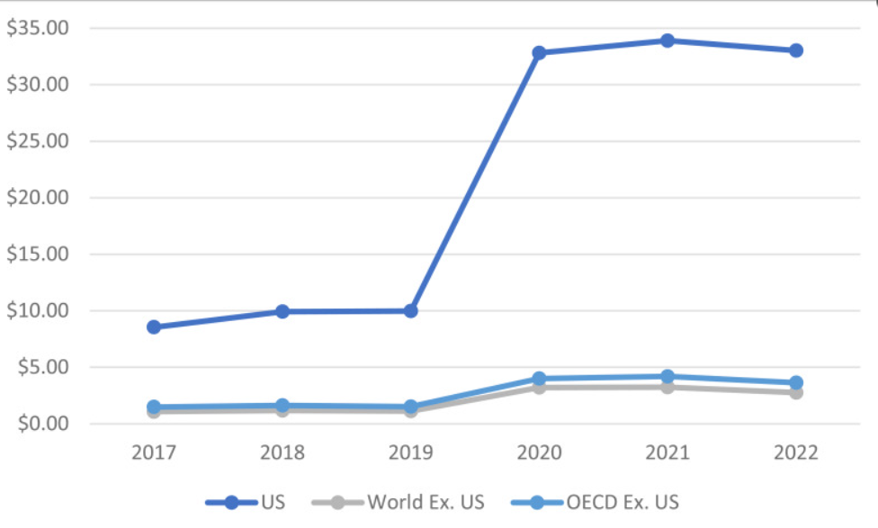

Prescription drugs have been very expensive for years
Brand drugs are able to consistently raise their prices since they have no competition in their specific market.
Many of the companies researching and producing the drugs wanted to maximize the profits being made.
Figure by National Library of Medicine on the average price per unit for top 50 drugs according to US sales
History of Drug Prices

Slide 3

Why are costs so high?
Legal maneuvers
Profits
PBMs
Cost-sharing
Advertising
“in Europe…the very same drugs made by the same companies for the same health problems typically cost far less than in the US.”
Pharmacy benefit managers negotiate the prices of drugs for health insurers and pharmacies.
Higher PBM fees means higher prices.
Higher copays, deductibles, and premiums from insurers lead to higher prices for consumers.
Drug makers will file multiple patents to keep hold of a drug as well as create similar drugs to patent it as a new creation.
Lots of money will be spent on ads, as well as the want for newer drugs that can be advertised.
Harvard article by Robert H. Shmerling, MD

Slide 4





Why is this important
The average American can’t afford high priced prescription drugs when the cost of living has gone up and will continue to increase.
Generic medicines are much cheaper than brand-name medicines, yet they can sometimes come with risks.
For some people, they need certain drugs to be able to survive, such as those with diabetes who take insulin.

Slide 5


Why change is important
Being able to use AI to help with drug development will allow for medicine to be purchased at a much lower price while still keeping the high quality.
Being able to make healthcare as affordable as possible should be the goal.
The lower development costs can lead to lower prices as customers won’t need to be overcharged to.

Slide 6
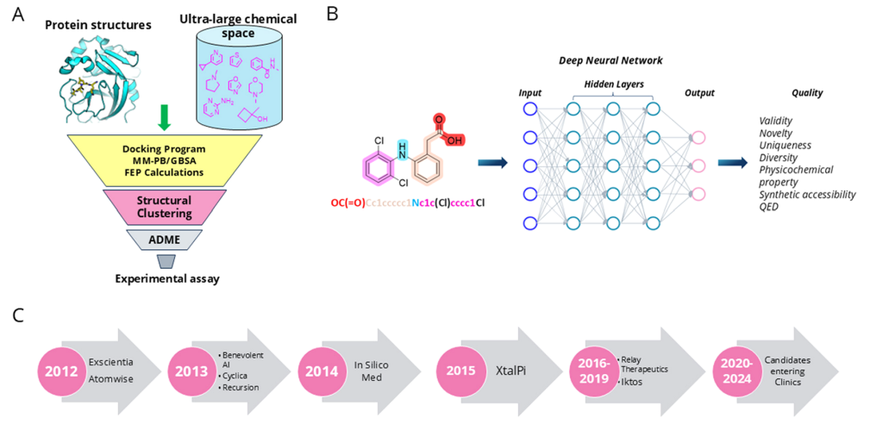
CADD: Computer-Aided Drug Design
AIDD: Artificial Intelligence Drug Discovery
CADD uses computer algorithms to predict how a drug molecule will interact with its target.
AIDD uses “large data sets from existing public or proprietary data repositories.”
(A) General workflow of CADD. (B) Molecular generation by deep learning architecture. (C) Examples (non-exhaustive) in the evolution of AI companies in the past decade.
CADD & AIDD
Article about small molecule drug discovery

Slide 7
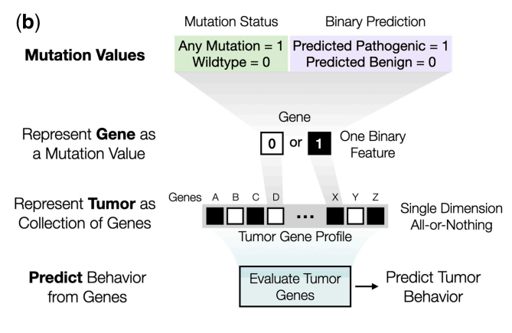
Labeled as a binary encoding method
Not mutated = 0
Mutated = 1
CADD is able to do this and create mutation-specific QMS values for different mutation types
“...each gene is assigned either a 0 or 1 based on the absence or presence of non-synonymous coding mutations (Fig. 1b). Combining mutation values across genes creates a genomic profile of a tumor, which multi-gene models use to predict tumor behaviors.”
CADD

Slide 8
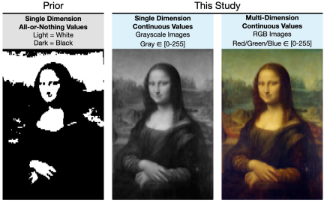
QMS- Quantitative Mutation Scoring
Uses AI through machine learning and gene mutation prediction
This study was specifically for predicting cancer drug responses
“...multiple mutation scores can be combined to create a multi-dimensional representation of gene mutations…”
“By analogy, if binary gene mutation states (0/1) are akin to a black-and-white photograph (Fig. 1e, left), moving to QMS reveals a more nuanced grayscale image (Fig. 1e, middle), while combining continuous values across multiple dimensions yields a fullcolor picture (Fig. 1e, right).”
CADD

Slide 9
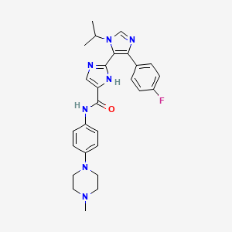
One of the first AI-generated drug candidate made for treating idiopathic pulmonary fibrosis(IPF)
Completed in 18 months from the initial target discovery to the preclinical candidate nomination. Results so far show it is safe and well tolerated.
“exhibits desirable drug-like properties and anti-fibrotic activity across different organs in vivo through oral, inhaled or topical administration”
A small-molecule TNIK(TRAF2- and NCK-interacting kinase) inhibitor developed by Insilico Medicine.
INS018_055

Slide 10

My Thoughts
Lower prices for essential drugs should be the goal. Healthcare should be affordable, or even free.
Generic drugs don’t work for everyone, it shouldn’t be the next best option because of price.
AI should be used for benefiting humanity. This is a great opportunity to do so.

Slide 11



Question 1
Can AI really understand biology?
Question 2
Would you buy/consume drugs that were developed by AI and is confirmed to be safe?
Discussion Questions
Question 3
Question 4
Would you participate in a clinical trial for a drug made by AI?
Do the lower prices entice enough you to overlook the possibly unknown side effects compared to manmade drugs?
Question 1 from small molecule article

Slide 12
References
Aam. “Skyrocketing Drug Prices: What’s Driving up Costs?” Association for Accessible Medicines, 14 Apr. 2025, accessiblemeds.org/resources/blog/skyrocketing-drug-prices-whats-driving-costs/.
Center for Drug Evaluation and Research. “Artificial Intelligence for Drug Development.” U.S. Food and Drug Administration, FDA, www.fda.gov/about-fda/center-drug-evaluation-and-research-cder/artificial-intelligence-drug-development. Accessed 28 Feb. 2026.
Chun, Matthew. “How Artificial Intelligence Is Revolutionizing Drug Discovery - Petrie-Flom Center.” Petrie, 23 July 2025, petrieflom.law.harvard.edu/2023/03/20/how-artificial-intelligence-is-revolutionizing-drug-discovery/.
Current Status of Computational Approaches for Small Molecule Drug Discovery | Journal of Medicinal Chemistry, pubs.acs.org/doi/full/10.1021/acs.jmedchem.4c02462. Accessed 28 Feb. 2026.
Fu, Chen, and Qiuchen Chen. “The Future of Pharmaceuticals: Artificial Intelligence in Drug Discovery and Development.” ScienceDirect, 26 Feb. 2025, www.sciencedirect.com/science/article/pii/S2095177925000656#sec4.
Giusti, Natasha. “How Ai Can Make Drug Discovery Faster, Better and Cheaper.” Sanford Burnham Prebys, 22 Apr. 2025, sbpdiscovery.org/how-ai-can-make-drug-discovery-faster-better-and-cheaper/.
Huanbutta, Kampanart, et al. “Artificial Intelligence-Driven Pharmaceutical Industry: A Paradigm Shift in Drug Discovery, Formulation Development, Manufacturing, Quality Control, and Post-Market Surveillance.” ScienceDirect, 16 Oct. 2024, doi.org/10.1016/j.ejps.2024.106938.
“Ins018_055.” National Center for Biotechnology Information. PubChem Compound Database, U.S. National Library of Medicine, pubchem.ncbi.nlm.nih.gov/compound/Ins018_055#section=Structures. Accessed 28 Feb. 2026.
Malariaworld, media.malariaworld.org/s10822_024_00552_6_378fb8dedb.pdf. Accessed 28 Feb. 2026.
Niazi, Sarfaraz K, and Zamara Mariam. “Computer-Aided Drug Design and Drug Discovery: A Prospective Analysis.” Pharmaceuticals (Basel, Switzerland), U.S. National Library of Medicine, 22 Dec. 2023, pmc.ncbi.nlm.nih.gov/articles/PMC10819513/.
Parasrampuria, Sonal. “Comparing U.S. and International Market Size and Average Pricing for Prescription Drugs, 2017-2022.” National Center for Biotechnology Information, U.S. National Library of Medicine, www.ncbi.nlm.nih.gov/books/NBK611829/. Accessed 28 Feb. 2026.
Paul, Debleena, et al. “Artificial Intelligence in Drug Discovery and Development.” Drug Discovery Today, U.S. National Library of Medicine, Jan. 2021, pmc.ncbi.nlm.nih.gov/articles/PMC7577280/.
Ren, Feng, et al. “A Small-Molecule TNIK Inhibitor Targets Fibrosis in Preclinical and Clinical Models.” Nature News, Nature Publishing Group, 8 Mar. 2024, www.nature.com/articles/s41587-024-02143-0#Sec1.
Ren, Feng, et al. “A Small-Molecule TNIK Inhibitor Targets Fibrosis in Preclinical and Clinical Models.” Nature News, Nature Publishing Group, 8 Mar. 2024, www.nature.com/articles/s41587-024-02143-0#Sec1.
Report to Congress Prescription Drug Spending, Pricing Trends, and Premiums, www.dol.gov/sites/dolgov/files/ebsa/laws-and-regulations/laws/no-surprises-act/2024-report-to-congress-prescription-drug-spending.pdf. Accessed 28 Feb. 2026.
Representing Mutations for Predicting Cancer Drug Response | Bioinformatics | Oxford Academic, academic.oup.com/bioinformatics/article/40/Supplement_1/i160/7700872?login=false. Accessed 28 Feb. 2026.
Robert H. Shmerling, MD. “Why Do Your Prescription Drugs Cost so Much?” Harvard Health, 18 Jan. 2024, www.health.harvard.edu/blog/why-do-your-prescription-drugs-cost-so-much-202401183007.
Torreele, Els. “Why Are Our Medicines so Expensive? Spoiler: Not for the Reasons You Are Being Told….” The European Journal of General Practice, U.S. National Library of Medicine, Dec. 2024, pmc.ncbi.nlm.nih.gov/articles/PMC10836477/.

